Slide 1
Instructions
The Virtual Storage Platform One deck is split into the following sections and is designed for you to choose the slides you need to present to your customers.
1
MAIN PRESENTATION : Virtual Storage Platform One presentation to be used with your customers and partners
2
SUSTAINABILIY: What is coming next from our sustainability story for infrastructure
3
PARTNER COMMUNITY: messaging specific to our partner community
4
TIMELINE: What is the timeline for the Virtual Storage Platform One GTM

Slide 2
One Hybrid Cloud Data Storage Platform
Presenter Name
Notes:
Hello and welcome, in this presentation we will cover off Hitachi Vantara’s vision, a new data storage strategy to simplify your hybrid-cloud experience. To unlock your application flexibility, mobility and ultimately achieve total data freedom. Allowing your data to be available on the right solution at the right time.
This vision is all about storing data, engineered in Japan with Hitachi Vantara’s legendary reliability, availability and serviceability.
Lets jump in!

Slide 3
Businesses Evolve
Data in Motion
Data is highly distributed with todays hybrid-cloud model creating data silos.
Data Unknowns
Data value is unknown, is it a liability, rubbish or pivotal to growth.
$3.1
Trillion
Is wasted every year in the USA storing very poor-quality data.
Notes:
BUSINESSES EVOLVE
Data is at center of almost every modern innovation today, and becoming more data-driven is a foundational goal for most digital transformation initiatives.
Placing data at the center of your organization significantly improves decision-making, improves operational efficiency, democratizes insights, and accelerates the performance of digital initiatives.
Research by McKinsey has found that data-driven organizations are 23 times more likely to WIN customers, six times more likely to KEEP customers and 19 times more likely to be profitable.
But, storing data is a challenge, we all know about the explosion of capacity and the reduction of budgets, but in reality it’s how to manage the configuration and consumption of these solutions.
Today we are in the world of hybrid cloud, seen as the savior of the complex data center and integrating private cloud and public cloud models.
Reality is different!
CIRCLE 1
Data is highly distributed across many different data types and deployments, from block, file, and object we start to build separate hybrid-cloud solutions. These even stretch into different deployment types from appliances to software-defined. Now you may have many silo hybrid-cloud solutions across many different deployments with their own management interfaces. Welcome to Multi-cloud complexity!
CIRCLE 2
Equally do we have a good understanding of the data being stored in the first place and its value to the business. Data only has a value when we know what it is, is it a liability? Is it needed for complicance? Is it highly accessed? Or is it just rubbish…. The right data becomes pivotal to growth.
CIRCLE 3
To give you an idea of 3.1 Trillion dollars is wasted each year in the USA alone in storing very poor quality data that has little value.

Slide 4
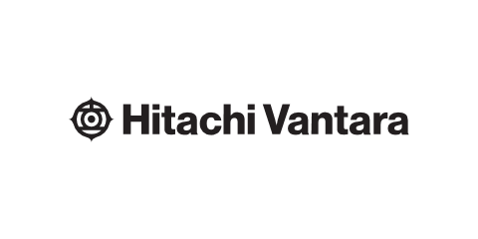
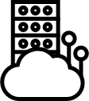




Businesses Evolve
Together we help enterprises deliver greater business value through data “FIRST”
Flexible
Intelligent
Resilient
Sustainable
Trusted
Choice: what, where, how
AIOps, Data Smarts
Unbreakable is critical
Eternity design mindset
Trust is earned, that’s why
Zero
Compromise in Data availability, simplicity
214%
Improved ROI with EverFlex aaS
70%
Reduction in manual IT tasks
90%
Faster resources delivery and proactive issue resolution
100%
Data Availability Guaranteed
#1 for the last
5 years
Rated for Reliability Availability and Serviceability by leading industry analysts
75%
Improved storage efficiency
-38% Co2
Compared to other rivals who manufactured in Asia
85%
Fortune Global 500 choose Hitachi Vantara to store their data
9 of top 10
financial institutions, Telcos, and media entertainment
companies trust us
Notes:
DATA FIRST
The first step in achieving total data freedom is to focus on data first, we can deliver greater business value through Data First. What does that mean?
Flexible > Businesses evolve. We help enterprises deliver greater business value with flexible, scalable, always-on data infrastructure solutions.
Intelligent > Smarter is better. Software-driven infrastructure and AIOps automation ensure that data is in the right place at the right time, adapting at the speed of business.
Resilient > Unbreakable is critical. Our data infrastructure solutions are resilient and reliable, for 100% data availability 100% of the time—guaranteed.
Sustainable > Eternity design mindset. create a genuine, measurable impact 75% Improvement in storage efficiency, 58% data reduction, 50% data center footprint reduction.
Trusted > Trust is earned. That’s why 85% of Fortune Global 500, 9 out of the top 10 financial institutions, Telcos, and media entertainment companies trust Hitachi Vantara

Slide 5



To evolve business flexibility, simplicity is a must.
Today’s hybrid cloud is a mix of siloed products with no ability for applications to directly consume and transit between infrastructure deployments. Additional software to consume these siloes offers no application flexibility.
Appliance
Software-Defined
Integrated Solution
Notes:
To evolve business flexibility, simplicity is a must.
How can we evolve complicated multi-cloud solutions into a platform for change. Mobility and Simplicity!
Here is a great example of this complexity in action, as you can see we have 3 hybrid-cloud solutions deployed an appliance, Software-defined and an integrated solution.
Looking at data lifecycle we might want to start on a appliance and then move to Software defined or expand our integrated system by using additional capacity in a separate cloud.
In most cases vendor solutions are silos not allowing for data to be easily transported non-disruptively to the right solution at the right time.
What is worse? All 3 have separate management interfaces, software, feature naming etc etc.
To evolve business flexibility we need simplicity
Allow applications to directly consume what they need and transit between infrastructure deployments without any additional software to consume these siloes.

Slide 6
Achieve Total Data Freedom
Allow applications to consume the right solution at the right time.
Enable applications on siloed solutions to interact with each other.
Govern one platform while applications manage it.
Notes:
To achieve total data freedom we need 3 things;
1st lets unshackle applications to consume the right solution at the right time.
2nd enable those freed applications on their silos to interact with each other.
3rd lets manage, consume and govern your data platform while your applications consume it.
To realize this dream Hitachi Vantara have been working hard in our engineering centers in Japan and across the globe to make this new strategy a reality!

Slide 7
Data Platform
One
Strategy
One data infrastructure platform
+
Data Management
One data management software family
Notes:
One Strategy
Our new data platform strategy, announcing October 10, 2023 falls into 2 simple directions.
One Data Infrastructure Platform - bringing our portfolio of data storage products together into one platform that our customers and partners can consume.
One Data Management Software – bringing the value of our infrastructure software into one family to sit across the one data platform.
With that I would like to play a quick video to introduce our new data first strategy:

Slide 8

Notes:
video

Slide 9

Virtual Storage Platform
One
仮想ストレージ プラットフォーム One
Notes:
Introducing Virtual Storage Platform One - The Ultimate Data Storage Platform

Slide 10
Data
Platform
データプラットフォーム
Notes:
Now we have introduced Virtual Storage Platform One, lets dive into what makes up the Data Platform!

Slide 11
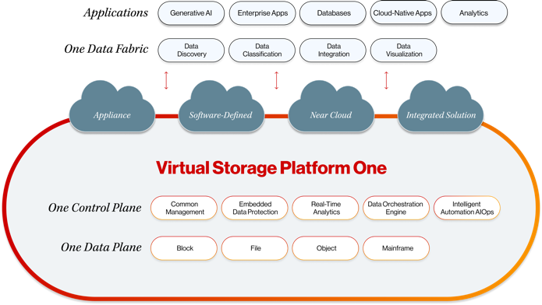
The data platform r/evolution.
Notes:
The data Platform revolution / evolution
Virtual Storage Platform One will enable customers to run, manage, and exploit their applications anywhere, from on-premises, to cloud, to edge. In addition to enabling data management and accessibility, this platform is designed to help them do more with their data, too. With this visionary new approach, we are creating a single, highly intelligent data fabric that’s powered by AI and supports all data types across all environments.
No longer will you and your customers need to spend time and resources attempting to cobble together disparate environments, and determine which infrastructure solution model will work best. Virtual Storage Platform One will support block, file, object and mainframe workloads in the fullness of time, but you can deploy it as an appliance, software defined or running in the public cloud, all from a single platform – clearly future-proofing the freedom of data across platforms.
Shift the focus onto the applications, allowing them to consume the infrastructure they need!

Slide 12
A hybrid data platform without compromise.
妥協のない 1 つのデータ プラットフォーム
Enable applications to consume the infrastructure it needs
One Data Fabric
Control infrastructure as one data solution
One Control Plane
Allow application data to flow between silos
One Data Plane
Notes:
A hybrid data platform without compromise.
ONE DATA PLANE - We have a common storage virtualization operating system (SVOS) across our storage portfolio and extending out to our software-defined storage offerings. Building a common data plane enables the transportation of infrastructure data between solutions. At the same time our file and object storage data services sit atop SVOS enabling us to extend the data plane for each of the different data deployment types.
ONE CONTROL PLANE - Ops Center data management will build a common control plane across solutions allowing you to administer, manage and consume services. All customers will start with our fleet management engine, Clear Sight, and build out the AIOps software they need to automate their platform .
Therefore, you have a common data plane (for each data type), a common control plane (across all deployments) and now a common data fabric for your applications to consume on one platform. This is unique!

Slide 13
Applications matter!
アプリケーションが重要
Enterprise Apps
Hypervisors
Edge
Mainframe
Databases
Cloud Native Apps
Virtual Storage Platform One natively supports storage-as-code,
so, applications can consume the resources they need directly.
Notes:
Applications Matter!
Virtual Storage Platform One does not need a software layer to deliver storage-as-code, our platform is fully configurable via APIs! Allowing the platform to be consumed and automated directly from 3rd party tools like ServiceNow or BMC Helix (Remedy). Also no limitations in our direct software plugins removing the need to use embedded management tools within the platform, just go directly from your applications.

Slide 14

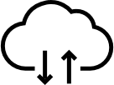




Secure & flexible consumption across hybrid-cloud.
Virtual Storage Platform One runs natively within public cloud providers, building a bridge for applications from on-premise into the cloud.
AWS
GCP
AZURE
Cloud Migration
Cloud Copy
Cloud Replication
Virtual Storage Platform One
Public Cloud
Virtual Storage Platform One
Easy migration of application data directly into the public cloud.
Improve system resilience with remote copy and data replication.
Simple deployment of workloads on public cloud.
Private Cloud
Notes:
Secure & flexible consumption across the public-cloud
Virtual Storage Platform One is designed to run natively within public cloud providers, building a bridge for applications from on-premise into the cloud of your choosing. Allowing you to spin up data services directly from within the hyperscale's marketplaces but all managed from within our data management software.
Here are some example use cases:
Cloud Migration : Easy migration of application data directly into the public cloud.
Cloud Copy : Improve system resilience with remote copy and data replication.
Cloud Replication : Simple deployment of workloads on public cloud.

Slide 15


Don’t leave existing infrastructure behind.
Extend existing storage investments into Virtual Storage Platform One
  Extend the Benefits of Common Management Centralized data management of day-to-day administration and operations.
  Non-disruptively Migrate Workloads
  Easily migrate workloads when it is time to decommission older storage products.
  Extend the Life to Aging Data Assets
  Enable modern data management features on older existing storage arrays.
  Future Proof
  Consolidate storage silos by virtualizing 3rd party storage assets.
Notes:
Don’t leave existing infrastructure behind
Hitachi Virtual Storage Platform is an industry leader in storage virtualization:
>21,000 virtualization storage controllers shipped
>40% of customers actively use external storage virtualization
Starting in 2010, Hitachi Dynamic Provisioning penetration rate >50%
>500PB storage under management, 50% virtualized
Virtualization provides a common virtualized pool of storage to provision storage for various application workloads. Now manage a mix of storage products from a single management interface with a common set of tools across all platforms. Virtualizing external 3rd party arrays, means businesses can adapt to new environments, extend useful life of hardware, ease migrations and more quickly assume management of acquired environments.
Virtualization now supported with Fibre Channel and/or iSCSI connectivity.
Extend the Benefits of Common Management Centralized data management of day-to-day administration and operations.
Non-disruptively Migrate Workloads
Easily migrate workloads when it is time to decommission older storage products.
Extend the Life to Aging Data Assets
Enable modern data management features on older existing storage arrays.
Future Proof
Consolidate storage silos by virtualizing 3rd party storage assets.

Slide 16

Remove the need for data migration.
Modern Storage Assurance
  Invest in the Hitachi Vantara portfolio today! With Modern Storage Assurance get Virtual Storage Platform One tomorrow!
  All upgrades and non-disruptive migration services to Virtual Storage Platform One are included. Upgrade within 1-5 years to accelerate applications next generation data platform.
Notes:
Remove the need for data migration - Performance Without Configurations
Modern storage assurance allows you to invest in the portfolio today but get VSP One tomorrow!
All upgrades are non-disruptive removing long expensive migrations to new solutions.
Lowering CO2 impact across the portfolio.
No need to commit to a new contract, your upgrade is yours!
Future proof your VSP storage investment with the ability to utilize all-NVMe, hybrid and all-flash configurations, in addition to intermix NVMe and SAS technologies, to get the best storage performance aligned to the value for your business.

Slide 17




Your solutions are more than just Hitachi Vantara
Build the right solution for your business with partners certified on the platform.
Virtual Storage
Platform One
Community
Notes:
A data solution is more then just a platform. Have the confidence to build the right solution with the right partners certified on VSP One.
For industry-specific appliances or integrations, we will position them as part of the VSP One Marketplace. Showing our alliances as part of our platform allows our customers and partners to choose what is right for them

Slide 18
Data
Management
データマネジメント

Slide 19
Customer Experience Portal
Hitachi Ops Center Infrastructure Software
Ops Center Clear Sight
Start at the beginning.
All Virtual Storage One customers interact with Clear Sight, a cloud-based customer experience portal for fleet management with integrated element managers.
Block Element Manager
File Element Manager
SDS Element Manager
Object Element Manager
Ops Center Advanced
Expand with AIOps.
Fully featured automation platform with integrated data protection, powered by machine learning analytics, gives you the best data administration software in the industry.
Analytics
Automation
Protection
Data Intelligence
Notes:
A Platform is nothing without an experience, Hitachi Ops Center will be elevated as our brand for infrastructure data management. Ops Center Clear Sight will lead as the Customer Experience Portal, giving observability to all Hitachi Vantara infrastructure with built-in element managers to administer the embedded software. Ops Center will still include the software in Ops Center today as our AIOps software suite, allowing for new projects to be developed and launched under the Ops Center family.

Slide 20
Self-deploying Infrastructure
Virtual Storage Platform 360
  Infrastructure-as-Code
VSP 360
Data Management
Capture
Store
Transform
Publish
Consume
Action and inform infrastructure decisions based on SLAs driven by AIOps.
Act and inform based on application requirements including governance and data protection.
VSP One
Data Platform
  Deliver intelligence on what data is being stored and define requirements for storage optimization and insights.
  Translate Managed Data into business Outcomes.
Notes:
VSP 360
The next customer experience 2.0 is key to cross the entire platform, building a true data services platform ontop of VSP One.
Remove the complexity of integrating and consuming solutions with an AI and ML driven portal across all block, file and object data services.
This is our data consumption engine that will integrate with a CMP
Applications are pointed to 360, 360 will then deploy the workload on the correct infrastructure for the application. The meta data for this deployment will be help in 360 and not within hardware.
This enables 360 to transport the application data across the platform without any impact or downtime.

Slide 21
Sustainability
サステイナビリティ
Notes:
Sustainability is key to all of our success as we seek to lower our impact on the planet, our strategy here is unwavering.

Slide 22

Notes:
video

Slide 23

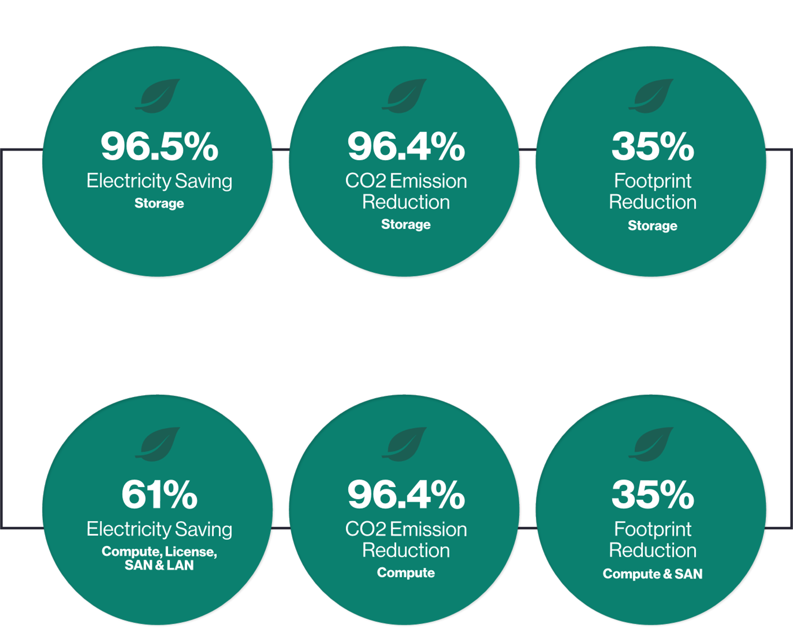




Decarbonization is more than a product, it’s about your supply chain.
Our storage platforms are manufactured in Japan which produces 38% less CO₂ than other major manufacturing locations.
Always ask your vendor where your solution is manufactured, it matters!
Modern Storage Assurance
Remove the need for expensive migration services (it’s included).
Up to approx. 33%
reduction
27
kg-CO₂
/TB･year
CO₂ emission/
1TB・1 year
(kg-CO₂/TB・year：From CFP certified values^{*1})
Up to approx. 42%
reduction
18
kg-CO₂
/TB･year
11
kg-CO₂
/TB･year
$1.4M
Estimated Annual Saving (USD)
4
kg-CO₂
/TB･year
CFP: Carbon Footprint of Products
VSP: Hitachi Virtual Storage Platform
VSP G1000
(year 2014)
VSP G1500
(year 2017)
VSP 5500H
(year 2020)
VSP 5600H
(year 2021)
Notes:
The Sustainable Data Center
Reduction of carbon footprint is more than storage efficiency all Hitachi Vantara VSP arrays are certified externally by the carbon footprint of products. The CFP reviews the whole circular economics of the solution, where do we source our materials? How to we transport them? Where do we manufacture? How do we power our software development? How do we ship to even our recycling.
Gartner recognized Hitachi Vantara VSP as having one of the lowest CO2 per TB per Year of any storage vendor in the 2023 storage magic quadrant.
VSP One is manufactured in Japan which which produces 38% less CO2 than rival manufacturing locations.
New unique eco patents will help deliver up to a 75% reduction of annual CO2 production vs previous Hitachi solutions.
Estimated Annual Saving (USD) 1.4m from a customer example
VSP One is manufactured in Japan which which produces 38% less CO2 than rival manufacturing locations.
VSP One solutions will be certified under various schemes and promoting energy saving and visualization of emissions.
New unique eco patents will help deliver up to a 75% reduction of annual CO2 production vs previous Hitachi solutions.
Graphics from
https://www.hitachivantara.com/en-us/pdf/ebook/ways-to-reduce-your-co2-footprint-save-money-ebook.pdf

Slide 24











Future Innovation
Dynamic workload control technology for renewable power consumption.
Use of renewable energy at each site.
Forecast of power generation
Data Center
Workload
prediction
Workload
distribution
control
Data Center
Data Center
Workload distribution control in response to fluctuating renewable power generation.
Data Center
Notes:
Future Innovation
What is coming next? Our strategy is to continue our sustainable innovation for everyone, Dynamic workload control technology allows for data to be migrated between localities based on available renewable power consumption.
As one location looses sunlight or lack of wind production data can be dynamically migrated without any impact to the business applications. Allowing for dynamic workload distributed
This is based on the forecast of power generation from Hitachi Energy. YES we have our own power company! Watch this space as we continue to innovate in this space.

Slide 25
Partner Community
パートナーコミュニティ

Slide 26
Be more competitive and ease the sales cycle by selling what the customer needs and no more!
Modern Storage Assurance
Support Block, File, Object and Mainframe on one data platform
Sell as an appliance, software-defined or in the public cloud
Virtualization of 3rd party systems to bring them into the platform and add data mobility at no risk.
Deliver one common data infrastructure software.
Today
Modern Storage Assurance sell VSP E / 5000 series and recognize the revenue for Virtual Storage Platform One now!
Notes:
VSP One is currently a strategy announcement, but the new platform will not throw our heritage away. This is a great way to expand your trusted conversation with customers today, show them our platform story and focus on our key tenants of reliability and availability.
We will transition our customers into the new platform without pain, so there is no reason to not sell our portfolio today. Modern Storage Assurance (MSA) helps you sell VSP One today with every VSP E / 5000 series array today, any MSA customer will receive a non-disruptive upgrade to our next generation data platform. Removing the need for expensive data migration services and lowering data center CO2 in the progress.
VSP One is planning to GA solutions over the next 36 months, below are the current firm GA dates with public facing launches committed:
Feb 2024 – File, SDS block, SDS Cloud
July 2024 – Block, VSP 360 (data orchestration)

Slide 27
One platform for all your customers! Remove the complexity and simplify selling, quoting and training.
Portfolio consolidation removes silos
Remove hybrid-cloud offerings on product silos with VSP One
Upsell and cross sell block, file and object data solutions on one platform.
Simplifying quoting and ordering with a new decision grid focused on data type and deployment.
Today
Start changing the conversation from products to one data platform, focus on solving the challenges being solved by the platform.
Notes:
VSP One is an amalgamation of our portfolio, therefore we must define their place in our ordering tools and manuals. Currently we have over 70 product SKUs which makes it complicated, under our new ordering system (Conga) we have consolidated ordering for VSP One under a decision grid that will focus on the data type and deployment needed; simplifying quoting!
Externally products will not be publicizing as individual offerings, much like the hyperscale’s, we will focus on how we solve customer issues based upon our features (e.g. deliver mission critical application data access without complexity = Global Active Device).
We will still have specific names for solutions under the following titles to simplify ordering, support and technical documentation only. They should not be used externally:
Virtual Storage Platform One
VSP = Block
HNAS = File
VSS block = SDS block
VSS cloud = SDS cloud
HCP = Object

Slide 28


The Call To Action.
Block, file, object and mainframe data all on one platform.
Partner Connect Login (opt-in for communications)
Strategy Announcement 10/10!
Partner Connect Webinar October 2023
Live demos AWS Re:Invent / Gartner ICOS November / December
GA of File, Software Defined Storage (SDS) block and SDS cloud February 2024
GA of Block, Object and 360 July 2024

Slide 29
Timeline
タイムライン

Slide 30
Evolution of Capability
Virtual Storage Platform One Community
VSP One
VSP One
VSP One
VSP One
File
SDS Block
File
SDS Block
File
SDS Block
File
SDS Block
Cloud
Block
Cloud
Block
Cloud
Block
Cloud
Object
SDS File
Object
SDS File
Mainframe
Feb 2024
Launch
Mid 2024
Addition of Block Capability
2H 2024
Addition of Object and SDS File Capability
2025/26
Addition of Mainframe Capability
Notes:
Moving forward we will not be talking about individual products, instead, we will focus on how the platform can solve customer problems. This is based upon the unique IP developed within our solutions, therefore, VSP One will only include IP that has been developed by Hitachi Vantara.
Over the next 36 months any new products will be brought to market under the VSP One umbrella. This includes new VSP, VSS, HNAS and HCP solutions. Once we have new offerings under VSP One the old brands of VSP, VSS, HNAS and HCP will be retired.
With our launch in Q1 CY2024, PM have been working exceedingly hard to migrate HNAS and VSS solutions into VSP One. As soon as the new solutions are generally available, their brands will be removed from our catalog immediately. With this in mind, you will start to see VSP One leading these offerings first.
Under the VSP One platform you can still reference point solutions, these names will be reserved for ordering, support and technical documentation only:
HNAS will become “File”
VSS block will become “SDS Block”
VSS Cloud will become “SDS Cloud”
Our Unified Compute Platform (UCP) for both converged and hyper converged solutions will continue as an integrated solution using VSP One as a base for data solutions. We will focus on using the platform as a base for the development of integrated solutions that differentiate us from the competition

Slide 31
Top 5 Reasons Why
上位 5 つの理由

Slide 32
Top 5 Reasons Why
1
Simplifying the data infrastructure portfolio:
Virtual Storage Platform One will be the home for our block, file, object and mainframe data solutions.
Running as an appliance, software-defined or in the cloud.
2
We have a common storage virtualization operating system (SVOS):
across our storage portfolio and extending out to our software-defined storage offerings. Building a common data plane enables the transportation of infrastructure data between solutions. At the same time our file and object storage data services sit atop SVOS enabling us to extend the data plane for each of the different data deployment types. Ops Center data management will build a common control plane across solutions allowing you to administer, manage and consume services. All customers will start with our fleet management engine, Clear Sight, and build out the AIOps software they need to automate their platform.
3
Virtual Storage Platform One Community:
For industry-specific appliances or integrations, we will position them as part of the VSP One Community.
Showing our alliances as part of our platform allows our customers and partners to choose what is right for them.
4
Modern Storage Assurance (MSA):
helps you sell VSP One today with every VSP E / 5000 series array today, any MSA customer will receive a non-disruptive upgrade to our next generation data platform. MSA removes the need for expensive data migration services and lowers data center CO2 in the process.
5
Sustainability:
Virtual Storage Platform One will continue to help lower data center CO2 beyond 4kg/CO2 per TB per year.
Built in Japan VSP One has -38% CO2 then rivals built in Asia.

Slide 33
Thank You
Event: Architecting Future Innovations With Data
@HitachiVantara
Hitachi Vantara
@HitachiVantara
@HitachiVantara
Hitachi Vantara
Notes:
https://hitachivantara.brighttalk.com/?mkt_tok=Mzc1LUpPRS01NTEAAAGOJDZkmssASTRzQQjQqGExCviMFonR0GZ_cfEOfZGiUSkJ79q-ZjmbFVJiVVMg9mBD0cbL4M55YCGzRHu7JG6g
Virtual Storage Platform (VSP) One Event Unveils Bold New Infrastructure Strategy
Our VSP One launch event on October 10 is right around the corner. I’m excited to unveil our new visionary strategy that brings our portfolio of data storage products together into one easy-to-consume, scalable, and resilient platform. I’ll lead thought-provoking conversations among Hitachi Vantara leaders, industry experts, and strategic partners around the seismic shifts in innovation brought on by GenAI, the cloud, and explosive data growth. We’ll share how Hitachi Vantara can help customers navigate these shifts and achieve complete data clarity through our future-ready VSP One data platform strategy. Reserve your spot and learn more.

